Slide 1
Healthcare Cost Growth Benchmark
Technical Team Meeting #2
November 26, 2024

Slide 2
I. Welcome

Slide 3
Meeting Agenda
Time | Topic
2:00 p.m. | I. Welcome
2:05 p.m. | II. Meeting 1 Recap
2:15 p.m. | III. Healthcare Cost Growth Benchmark
 | Review of current total healthcare expenditure (THCE) measurement methodology
 | Methodology for setting the 2026-2030 healthcare cost growth benchmarks​ Decision-making criteria for the economic indicator on which the benchmark will be based Review of other states’ methodologies and values Review list of indicator options in Connecticut, e.g., gross state product, potential gross state product, median income, average wage (without discussion of a value for the benchmark) Historical and/or forecasted trends for indicators
3:55 p.m. | VII. Wrap-Up, Next Steps, and Public Comment
4:00 p.m. | VIII. Adjournment
Healthcare Cost Growth Benchmarks and Performance To Date

Slide 4
II. Meeting Recap

Slide 5
Technical Team Meeting #1 Recap
During the first meeting, OHS reviewed the charge and objectives of the Technical Team and presented a plan for achieving them.
We also reviewed background information about healthcare cost growth benchmarks and primary care spending targets in Connecticut and other states, including
  Connecticut’s legislation and governance structure
  Spending performance to date in Connecticut and in other states
  Equity considerations in benchmark programs
Technical Team Meeting #1 Recap

Slide 6
Meeting #1 Recap: Action Items
OHS sent the following additional information to the Technical Team in response to requests and discussion;
  OHS’s October report to the General Assembly, which includes legislative recommendations for meeting healthcare spending benchmarks.
  Reports and data on primary care spending
OHS also compiled information showing comparative state cost growth rates and per capita cost in response to the meeting discussion.
  The next few slides display the average cost growth rate from 2019-2022 by state, alongside the 2022 PMPY spending.
  This is shown for the statewide THCE and by market.
Meeting #1 Recap: Action Items

Slide 7
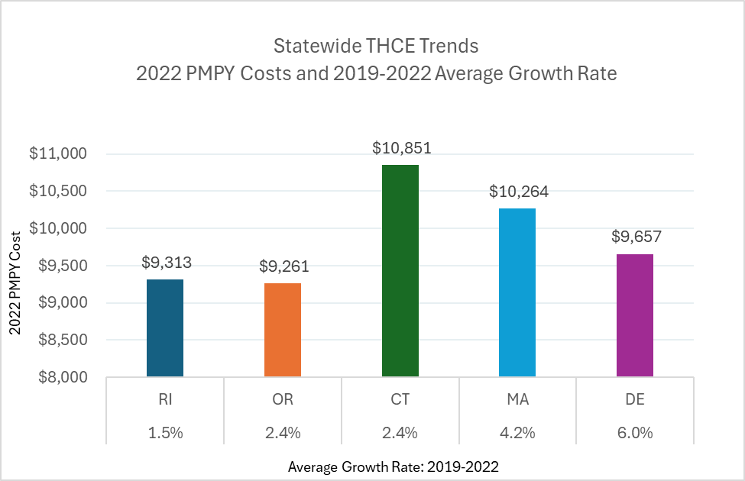
Comparative Cost Growth Rates and Per Capita Costs: Statewide THCE
The average cost growth rate for 2019-2022 is shown along the x-axis, in ascending order.
The y-axis represents 2022 per member per year (PMPY) costs.
Comparative Cost Growth Rates and Per Capita Costs: Statewide THCE

Slide 8
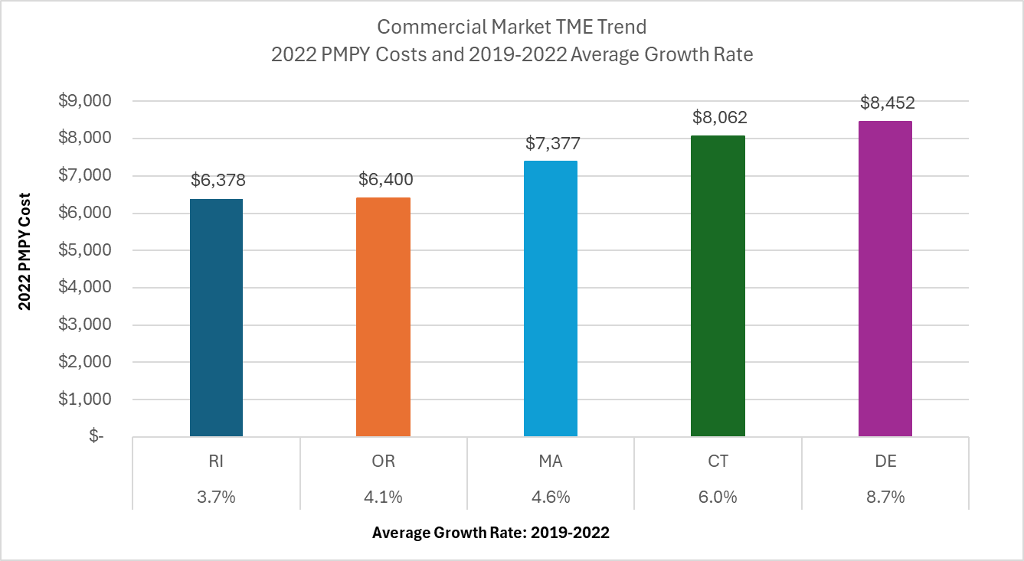
Comparative Cost Growth Rates and Per Capita Costs: Commercial Market
Comparative Cost Growth Rates and Per Capita Costs: Commercial Market
Notes:
Massachusetts commercial market data, which rolls up to the statewide THCE, uses a CHIA estimate of partial-claim data. CHIA estimates spending by product type by multiplying the share of member months reported in TME data by the estimated total commercial partial-claim expenditures.
HPC data that are reported use full-claims data only. We are using the CHIA data as the source but wanted to note this for additional context.

Slide 9
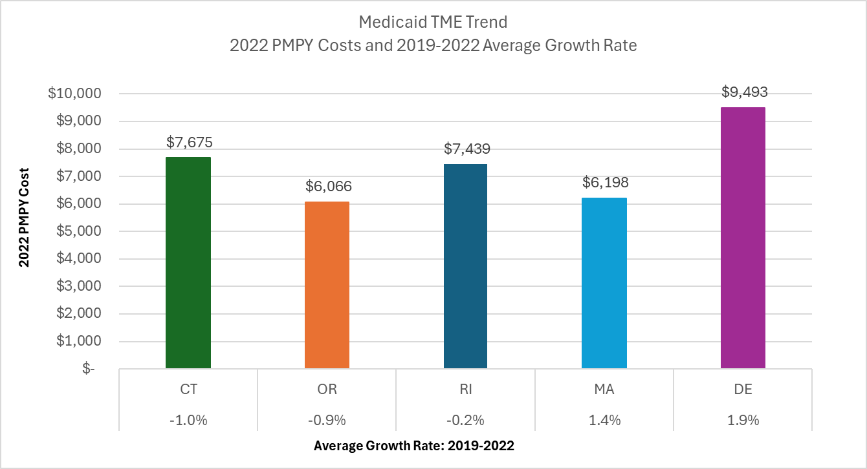
Comparative Cost Growth Rates and Per Capita Costs: Medicaid Market
Connecticut is the only state of those shown that does not have Medicaid managed care.
Comparative Cost Growth Rates and Per Capita Costs: Medicaid Market

Slide 10
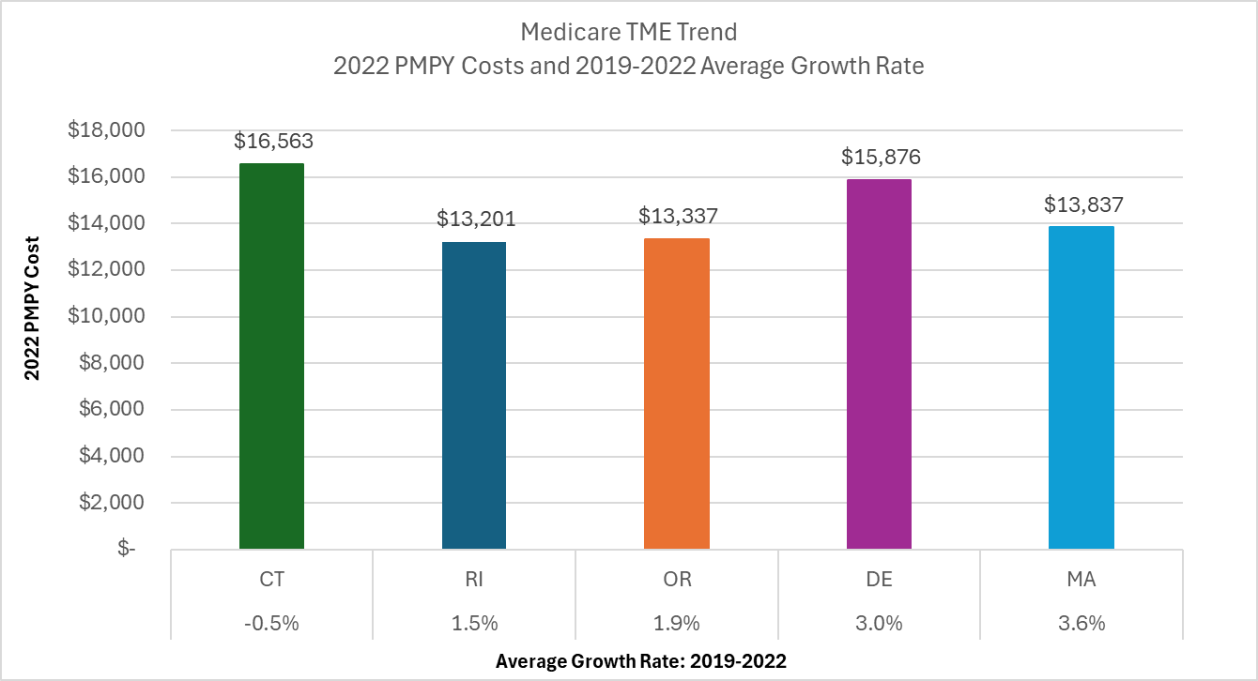
Comparative Cost Growth Rates and Per Capita Costs: Medicare Market
Comparative Cost Growth Rates and Per Capita Costs: Medicare Market

Slide 11
III. Healthcare Cost Growth Benchmark

Slide 12
A. Review of current total healthcare expenditure (THCE) measurement methodology
Notes:
Data source
Instructions to carriers
Validation
Review with payers and Advanced Networks

Slide 13
Current Total Healthcare Expenditure Measurement Methodology: Review
Defining total healthcare expenditures (THCE)
Determining whose total healthcare expenditures are being measured
Measuring total medical expenses (TME)
Levels of reporting spending relative to the healthcare cost growth benchmark
Current Total Healthcare Expenditure Measurement Methodology: Review
Notes:
This is a review of the 2021-2025 benchmark methodology design decisions. It is our intent to review the design decisions on this slide but not open them up for lengthy discussion or revisit them.
As was mentioned during the first meeting, we will follow a process like the one OHS implemented in 2020 with the Technical Team at the time; however, given a) the compressed timeline, b) the State’s implementation experience, and c) the benchmark statute, we will not use our time together to revisit every design decision. We will need to focus our time together on setting the cost growth benchmarks and primary care spending target.
That said, to provide this group with additional context, we will spend the next few minutes reviewing the following measurement and reporting methodological components:
Definition of total health care expenditures (THCE), which is in statute
Review categories of claims and non-claims payments, and cost-sharing
Expenditures that have been excluded from the calculation of THCE
Health care coverage categories that are measured (e.g., Medicare, Medicaid and commercial)
Residence of individuals whose spending will be measured and location of provider delivering the services
Population to use as the denominator for calculating per capita spending
Measuring total medical expenses (TME), including primary care attribution
Levels of reporting spending relative to the healthcare cost growth benchmark - During meeting 3, we propose to discuss additional aspects of reporting performance, beyond the levels, to include risk adjustment, truncation, and confidence intervals. I expect those to be design decisions for which OHS will want to engage the Technical Team in discussions (i.e., not just reviewing them.)

Slide 14
1. Defining Total Healthcare Expenditures
Healthcare benchmark programs provide a comprehensive view of healthcare spending for their residents, across public and private payers.
Total Medical Expense (TME)
Net Cost of Private Health Insurance (NCPHI)
Total Health
Care Expenditures (THCE)
All claims-based spending paid to providers by public and private payers, and net of pharmacy rebates
All nonclaims payments to providers
All cost-sharing paid by members, including but not limited to co-payments, deductibles and co-insurance*
The costs to state residents associated with the administration of private health insurance
The measure used to assess entities’ performance against the cost growth benchmark
1. Defining Total Healthcare Expenditures
Notes:
Connecticut statute.
"Total health care expenditures" means the sum of all health care expenditures in this state from public and private sources for a given calendar year, including: (A) All claims-based spending paid to providers, net of pharmacy rebates, (B) all patient cost-sharing amounts, and (C) the net cost of private health insurance; and
"Total medical expense" means the total cost of care for the patient population of a payer or provider entity for a given calendar year, where cost is calculated for such year as the sum of (A) all claims-based spending paid to providers by public and private payers, and net of pharmacy rebates, (B) all nonclaims payments for such year, including, but not limited to, incentive payments and care coordination payments, and (C) all patient cost-sharing amounts expressed on a per capita basis for the patient population of a payer or provider entity in this state.
"Net cost of private health insurance" means the difference between premiums earned and benefits incurred, and includes insurers’ costs of paying bills, advertising, sales commissions, and other administrative costs, net additions or subtractions from reserves, rate credits and dividends, premium taxes and profits or losses;
All states calculate total health care expenditures (THCE), a measurement defined as the sum of total medical expense (TME) plus the net cost of private health insurance (NCPHI). All states define TME in terms of provider payments.

Slide 15
Patient Cost-Sharing
Payers report the “allowed amount” on a claim, which includes a) the amount paid by the insurer to the provider and b) the patient’s financial obligation to the provider.
  It is the maximum allowed charge for a covered benefit.
  It includes the portion the patient owes the provider according to the patient’s benefit plan. It does not capture whether the patient actually paid what was owed.
Patient Cost-Sharing

Slide 16
Spending That is Not Included in THCE (1 of 2)
Patient out-of-pocket spending on non-covered services
  For example, non-medical cosmetic surgery and non-health care services-related discounts offered by an insurer (e.g., gym membership).
Spending by people who are not insured
  We lack a means to capture all payments made by individuals who are uninsured.
  While there are some point-in-time research estimates and survey data, there is no comprehensive data source to capture out-of-pocket spending by the uninsured. Similarly, there is no comprehensive data source on what insured consumers pay for non-covered services.
  THCE spending is typically calculated using payer-submitted data.
Spending That is Not Included in THCE (1 of 2)

Slide 17
Spending That is Not Included in THCE (2 of 2)
Uncompensated care
  Provision of care at no charge or at discounted rates (“charity care”) and care for which no payment was received for services provided (“bad debt” and write-offs) are not part of THCE.
  If “bad debt” is related to covered services for which the payer made a payment, it will be captured because the OHS is measuring payer “allowed amounts.”
  Uncompensated care represents a provider cost, not payer or patient spending.
Spending That is Not Included in THCE (2 of 2)

Slide 18
2. Determining Whose Total Healthcare Expenditures Are Being Measured
THCE includes spending on behalf of Connecticut residents who:
  have health insurance coverage through Medicare, Medicaid, commercial carriers (fully-insured and self-insured), Veterans Health Administration, or state correctional facilities, and
  receive care from any provider in or outside of Connecticut.*
When calculating statewide per capita spending, OHS uses the covered lives figures reported by payers.
*Spending for out-of-state residents receiving care from in-state providers is excluded from THCE.
2. Determining Whose Total Healthcare Expenditures Are Being Measured

Slide 19
3. Measuring Total Medical Expenses (TME)
Measuring spending growth of total medical expenses (TME) of Advanced Networks requires attribution or assignment of individuals to primary care providers and understanding of provider affiliation with Advanced Networks
  All healthcare spending on behalf of a member, regardless of where the services were received or by whom they were performed, are attributed to the member’s primary care provider.
  Primary care providers are attributed to the entity by which the provider is employed or with which it is otherwise affiliated.
3. Measuring Total Medical Expenses (TME)
Notes:
OHS requires payers to attribute and report spending to a primary care provider according to a tiered hierarchical attribution method: member selection of PCP; contract arrangement; utilization; unattributed.
OHS collects TINs from provider entities subject to the state’s cost growth target for the applicable performance years. The State provides that information to payers at the time of the data request and instructs payers to use the TINs to support attribution of clinicians to provider entities.

Slide 20
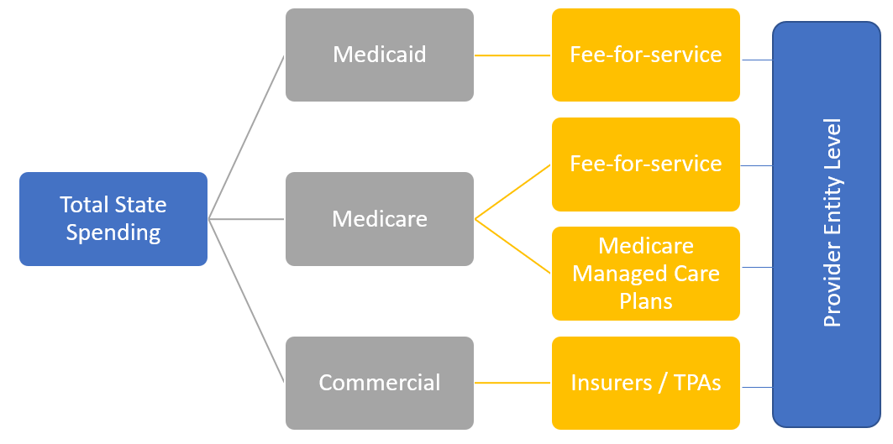
4. Levels of Reporting Spending Relative to the Healthcare Cost Growth Benchmark
During the next meeting, we will discuss whether OHS should report Advanced Network spending growth overall (i.e., across all markets) or by market, as is current practice.
Advanced Networks
(Provider Entities)
4. Levels of Reporting Spending Relative to the Healthcare Cost Growth Benchmark
Notes:
OHS has charged the Technical Team with discussing whether to report AN spending growth by market only or overall, across markets. During the third meeting, we plan to talk about performance reporting, specifically risk adjustment and improving statistical confidence.

Slide 21
B. Methodology for setting the 2026-2030 healthcare cost growth benchmarks​

Slide 22
Methodology for setting the 2026-2030 healthcare cost growth benchmark(s)​
We will now turn to discussion of setting the annual healthcare cost growth benchmarks for CYs 2026-2030. To facilitate this process, we will:
Establish decision-making criteria for the indicator(s) on which the benchmark will be based
Review other states’ methodologies and values
Discuss indicator options in Connecticut (without discussion of a value for the benchmark)
Consider whether to use historical or forecasted trends for indicators
Methodology for setting the 2026-2030 healthcare cost growth benchmark(s)​

Slide 23
Decision-making criteria for the economic indicator on which the benchmark will be based
OHS adopted decision-making criteria to guide selection of economic indicators to set the 2021-2025 benchmark values.
Why economic indicators?
  OHS sought an objective basis for the benchmark values.
  It was following the precedent set by the states that had previously established cost growth benchmarks (MA, DE, RI).
Decision-making criteria for the economic indicator on which the benchmark will be based

Slide 24

Decision-making criteria for the indicator(s) on which the benchmark will be based
OHS established that the indicators must:
  provide a stable and therefore predictable target;
  rely on independent, objective sources with transparent calculations; and
  result in a benchmark value that lowers growth in healthcare spending for consumers, employers, and taxpayers.
Do these criteria resonate with you?
Are there other criteria OHS should consider?
Decision-making criteria for the indicator(s) on which the benchmark will be based
Notes:
During the second meeting, Deidre said the goal is to ensure the benchmark is grounded in a solid, technical base and considers achievability. She added that benchmarks are only going to be effective to the extent that those that are subject to them believe they are achievable.

Slide 25
Review of other states’ methodologies and values
Before we get into discussion of the indicator options for the 2026-2030 benchmarks, let’s review methodologies in use by other states.
Eight states have adopted healthcare cost growth benchmarks to date.
  Between 2018 and 2022, states established target values ranging from 2.9 percent to 3.8 percent.
  Target values were roughly 2 percentage points less than the average annual state healthcare spending growth over the prior decade in each state.
Review of other states’ methodologies and values

Slide 26
Review of other states’ methodologies and values
All states have tied their targets to some measure of the economy, including state economic growth and/or indicators of resident income growth.
  As we observed last meeting, Connecticut places the highest weight of all states on a consumer-centric measure (median household income).
Each state reviewed several different indicators and considered the following questions:
  What does the indicator measure and is this relevant to the charge?
  What is the state signaling if it ties future healthcare spending growth to a particular indicator?
States also considered prior spending growth in their state commercial, Medicaid, and Medicare markets.
Review of other states’ methodologies and values

Slide 27
State Benchmarks and Methodologies (1 of 2)
State | Benchmark Methodology | Benchmark Value
California | Average annual rate of change in historical median household income from 2002-2022. Add-on factors: +0.5% for CY 2025-2026, +0.2% for CY 2027-2028, +0.0% for CY2029 | 3.5% for 2025-2026 3.2% for 2027-2028 3.0% for 2029
Connecticut | 80/20 blend of median household income and PGSP Add-on factors: +0.5% for CY 2021, +0.3% for CY2022, +0.0% for CY 2023-2025 | 3.4% for 2021 3.2% for 2022 2.9% for 2023 4.0% for 2024* 2.9% for 2025
Delaware | PGSP Add-on factors: +0.25% for 2021, +0.0% for CY2022-2023 | 3.8% for 2019 3.5% for 2020 3.25% for 2021 3.0% for 2022-2024
Massachusetts | 2013-2017: PGSP 2018-2022: PGSP (3.6% in 2018) minus 0.5% 2023 and beyond: default rate of PGSP, per statute | 3.6% for 2013-2017 3.1% for 2018-2022 3.6% for 2023-2025
*Modified from 2.9% to account for inflation
State Benchmarks and Methodologies (1 of 2)

Slide 28
State Benchmarks and Methodologies (2 of 2)
State | Benchmark Methodology | Benchmark Value
New Jersey | 75/25 blend of median projected household income and PGSP Add-on factors: +0.3% for 2023, +0.0% for 2024, -0.2% for 2025, -0.4% for CY2026-2027 | 3.5% for 2023 3.2% for 2024 3.0% for 2025 2.8% for 2026-2027
Rhode Island | PGSP for 2019-2022. 75/25 blend of PGSP and forecasted median household income growth for 2023-2027. Accounted for the lagged impact of inflation on health care costs by adjusting the PGSP inflation input with inflation experience on a two-year lagged basis for 2023-2025. | 3.2% for 2019-2022 6.0% for 2023 5.1% for 2024 3.6% for 2025
Oregon | Non-formulaic consideration of: historical GSP; historical median wage; CMS waiver & legislative growth caps applied to the state’s Medicaid and publicly purchased programs | 3.4% for 2021-2025 3.0% for 2026
Washington | 70/30 blend of historical median wage and PGSP, with a downward adjustment starting in 2024 | 3.2% for 2022-2023 3.0% for 2024-2025 2.8% for 2026
State Benchmarks and Methodologies (2 of 2)

Slide 29


Indicator options for Connecticut’s benchmarks
(1 of 2)
We have four economic indicators to share as possible options to inform the value of the 2025-2030 cost growth benchmarks. You are invited to suggest others.
  Connecticut’s Gross State Product (GSP)
  Connecticut’s Potential Gross State Product (PGSP)
  Median household income of Connecticut residents
  Average wage of Connecticut workers
We will describe:
  What the indicator measures and represents.
  What the “message” would be if the benchmark target was set to the indicator being considered.
Indicator options for Connecticut’s benchmarks (1 of 2)
Notes:
Messaging is important, as it provides the rationale for how and why the benchmark is chosen.
Indicator data sources
GSP: Connecticut Office of Policy and Management
PGSP: Connecticut Office of Policy and Management using S&P Global Forecast
Median Household Income (historical and forecast): Connecticut Office of Policy and Management using S&P Global Forecast
Average Wage (historical): Connecticut Department of Labor, Office of Research, Quarterly Census of Employment and Wages (QCEW) program
Average wage (forecast): TBD. We will need to request this from the Office of Policy and Management.

Slide 30
Indicator Options for Connecticut’s benchmarks (2 of 2)
Today we will discuss the options for the indicators without a discussion of the values they would produce.
During our next meeting, we will present modeling of indicators, based on the feedback and preferences expressed today.
  We will display values for each indicator of interest.
  We will whether there is a rationale for adjusting the benchmark value produced by the indicator(s) of interest, and if so, the manner in which the benchmark value could be adjusted.
Note: OHS’ statute requires legislative Insurance Committee approval if the average future benchmark value is more than .5% above or below the average benchmark value for 2021-25. That value is currently 3.3%.
Indicator Options for Connecticut benchmarks (2 of 2)

Slide 31
Option 1: Connecticut’s Gross State Product (GSP)
Gross State Product (GSP) is the total value of goods produced and services provided in a state during a defined period.
This is the state counterpart to Gross Domestic Product (GDP), which is measured at the national level, with a few methodological differences in how the figures are calculated.
GSP is often considered the main measure and key target of economic policy at all levels of government. The growth in GSP tells us how fast the state’s economy is growing.
By tying the benchmark to GSP, we would create an expectation that healthcare spending should not grow faster than the economy.
Connecticut’s Gross State Product (GSP)

Slide 32
Option 2: Connecticut’s Potential Gross State Product (PGSP)
Potential Gross State Product (GSP) measures the projected long-run average growth rate of a state economy, excluding fluctuations that may occur due to the business cycle.
It differs from GSP in that it is a forecasted measure of the economy and takes into account anticipated labor force productivity and participation, and inflation.
PGSP shows us what state economic growth is likely to be in the future. It is designed to be a stable benchmarking figure. It is used by many cost growth benchmark states.
By tying the benchmark to PGSP, we would create an expectation that healthcare spending should not grow faster than the state economy is forecasted to grow.
Connecticut’s Potential Gross State Product (PGSP)
Notes:
Source: This measure requires a combination of state, federal, and potentially purchased data from a third party (e.g., Moody’s Analytics).

Slide 33
How GSP and PGSP Measures Differ
Potential Labor Force Productivity
Labor Income
Gross Domestic Product by State
Potential Gross State Product
Inflation
Business Taxes
Potential Labor Force Growth
Capital Income
Population Growth
How GSP and PGSP Measures Differ

Slide 34
Option 3: Median household income of Connecticut residents
Household income is the sum of all payments received by individuals age 15+ in a household, even if unrelated.
  Sources of household income include wages, salaries, investment returns, income from estates and trusts, property income, retirement accounts, public assistance, child support or alimony.
It is the most comprehensive measure of total income as it includes all sources income
(not just wages).
Median household income represents the financial health of all households in the state and is a good measure of a typical income level for the state.
By tying the benchmark to median household income growth, we would create an expectation that healthcare spending should not grow faster than household income.
Median household income of Connecticut residents
Notes:
The U.S. Census Bureau calculates household income based on gross cash income of individuals age 15 years and older belonging to a household, regardless of whether household members are related. Median household considers all households in an area and is a relatively good measure of a typical income level for the area. Median household income tends to more accurately reflect the typical household of a geographic area than average household income, which can be distorted by a few extremely wealthy households.
By contrast, family income considers household units with two or more related individuals and represents the financial picture of families.

Slide 35
Option 4: Average wage of Connecticut workers
Wage growth measures the change in compensation individuals receive for work as an employee or a contractor with an employer.
It does not capture income such as capital gains, dividends, rent, or interest.
Wage growth does not explicitly factor in inflation, although historical wage growth will reflect its impact.
Wage may be a more tangible indicator for most individuals than “household income” as it more closely represents “take-home pay.”
Setting the cost growth benchmark to the growth of Connecticut residents’ wage growth implies that healthcare should not grow faster than “take-home pay” of Connecticut residents.
Average wage of Connecticut workers
Notes:
beginning on January 1, 2025, Connecticut’s minimum wage will increase from the current rate of $15.69 per hour to $16.35 per hour.
Average wages
Average annual wages per employee for any given industry are computed by dividing total annual wages by annual average employment. A further division by 52 yields average weekly wages per employee. Annual pay data only approximate annual earnings, because an individual may not be employed by the same employer all year or may work for more than one employer at a time.
Average weekly or annual pay is affected by the ratio of full-time to part-time workers, as well as by the numbers of individuals in high- and low-paying occupations. When comparing average pay levels among States and industries, data users should take these factors into consideration. For example, industries characterized by high proportions of part-time workers will show average weekly wage levels appreciably less than the weekly pay levels of regular full-time employees in these industries. The opposite is true of industries with low proportions of part-time workers and of industries that typically schedule heavy weekend and overtime work. Average wage data also may be influenced by work stoppages, labor turnover, retroactive payments, seasonal factors, and bonus payments.
Under most State laws or regulations, wages include bonuses, stock options, severance pay, the cash value of meals and lodging, tips and other gratuities, and, in some States' employer contributions to certain deferred compensation plans, such as 401(k) plans.

Slide 36
Additional Consideration and Three Big Questions
Some Connecticut hospitals have asserted that the future cost growth benchmark value(s) should factor in the costs of delivering care.
Should provider costs be a consideration when determining the benchmark value? Why or why not?
Are there other indicators OHS should consider? Why?
To which indicator(s) should OHS tie the 2026-2030 healthcare cost growth benchmark? Why?
Additional Considerations and Discussion

Slide 37
Economic Indicators: Historical and Forecasted Experience
There are differences in economic indicators calculated using historical actual data vs. forecasts.
Historical Experience | Forecasts
Historical data reflects, to varying degrees, the volatility of year-over-year changes, including booms and busts, e.g., the effects of the pandemic and its aftermath. Historical figures are relatively easy mathematical calculations (straight average growth over prior time periods). Anomalous events can be addressed through smoothing or by extending the period, but determining the appropriate time period is not always obvious; the decision can have substantive impact. | Forecasted data are designed to be predictable, stable figures and are often calculated by government agencies and private firms. The figures and methods of calculation vary. Private forecast methodologies are not available for scrutiny and can vary by the philosophy and outlook of the chief economists at each organization. They often prove to be inaccurate because economies are volatile over time.
Economic Indicators: Historical and Forecasted Experience

Slide 38
Discussion
Should OHS use historical trends or forecasts?
 | Historical | Forecasted
Advantages | Easy to calculate. Reflects actual experience. | Smooths out historical variability and provides more stability and predictability.
Disadvantages | Highly variable, reflecting economic booms and busts. Unclear rationale for which time period to choose. | Forecasts are predictions and may be incorrect. Forecast methodologies may be opaque.
Note: During our last meeting one Technical Team member observed that a portion of historical healthcare spending has been wasteful. We can discuss during our next meeting whether an adjustment should be made to the benchmark value to account for waste. No other state has made such an adjustment to date.
Discussion

Slide 39
V. Public Comment

Slide 40
VI. Wrap-Up and Next Steps

Slide 41
Wrap-Up and Next Steps
The next Technical Team meeting is scheduled for December 13, 2024, from 3:00-5:00 pm EST.
Wrap-Up and Next Steps

Slide 42
VII. Adjourn

