Slide 1
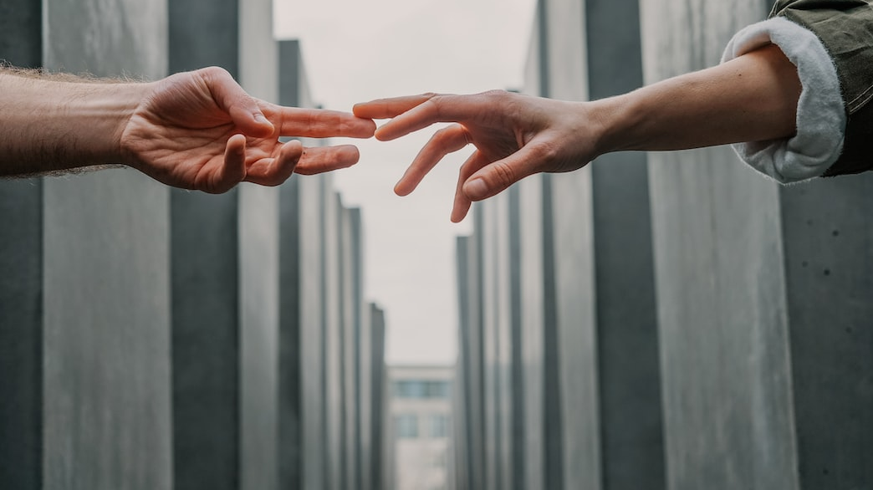
Benefits of Community Connection
Why We Need Each Other

Slide 2
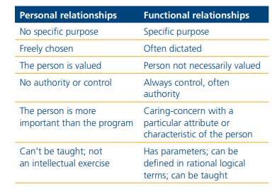
Functional or Personal Relationship
Is your life and community interactions with people you choose to be with ?
■ Personal relationships — are those we have with people because we want to, because we like someone
■ Functional relationships — are those we have with people for a reason, there is a specific function in the relationship
Research and Training Center on Community Living, Institute on Community Integration (UCEDD), at the University of Minnesota
What is the balance in your life between personal and functional relationships?
What is the balance in the life of the average person with a disability?
Most people with a disability have a disproportionate share of functional relationships in their life — their day often consists of people paid to spend time with them.
How would you feel about your day and about yourself if you had more functional relationships (people there because they had to be there) than personal relationships?
Angela Novak Amado, Ph.D.
What can be done to shift that balance and how can we assist with that?

Slide 3
Community Connections
Ways to connect
Recreation refers to all those activities that people choose to do to refresh their bodies and minds and make their leisure time more interesting and enjoyable. Examples of recreation activities are walking, swimming, meditation, reading, playing games and dancing.
Leisure refers to the free time that people can spend away from their everyday responsibilities (e.g. work and domestic tasks) to rest, relax and enjoy life. It is during leisure time that people participate in recreation and sporting activities.
Sport refers to any type of organized physical activity, e.g. soccer, rugby, football, basketball and athletics.

Slide 4
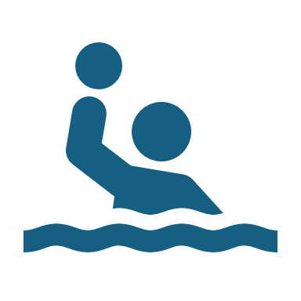
Recreation, leisure & sports play an important role in our communities.
Like culture and art, recreation, leisure and sports activities play an important role in communities. The many benefits include improving the health and well-being of individuals, contributing to the empowerment of individuals, and promoting the development of inclusive communities. Recreation, leisure and sports activities may involve individuals, small groups, teams or whole communities and are relevant to people of all different ages, abilities and levels of skill. The types of recreation, leisure and sports activities people participate in vary greatly depending on local context and tend to reflect the social systems and cultural values.
Participation in recreation, leisure and sports activities may be one of the few opportunities people with disabilities have to engage in community life beyond their immediate families or their functional relationships.

Slide 5
skills development – physical and social skills are some of the many skills that can be developed through participation in recreation and sports activities
Engaging in recreation, leisure and sports activities can have many benefits for both the individual and community.
These include:
international peace and development – sport is a universal language that can be used as a powerful tool to promote peace, tolerance and understanding by bringing people together across boundaries, cultures and religions
health promotion and disease prevention – recreation and sports activities are an enjoyable and effective way to improve health and well-being; they can relieve stress, increase fitness, improve physical and mental health, and prevent the development of chronic diseases, such as heart disease
awareness raising, reduction of stigma and social inclusion – recreation & sports activities are a powerful, low-cost means to foster greater inclusion of people with disabilities; they bring people of all ages & abilities together for enjoyment, & provide people with disabilities the opportunity to demonstrate their strengths and abilities, and promote a positive image of disability
The Benefits of Community
Participation
empowerment – recreation and sports activities can empower people with disabilities by positively influencing their self-
confidence and self-esteem.

Slide 6
How to facilitate or build community connections?
10 WAYS TO BUILD A SENSE OF COMMUNITY
  Volunteer
  Get to know your neighbors
  Join a community garden, social action group, church, etc.
  Join a local gym or sports league.
  Help people in need: conduct acts of kindness, donate, etc.
  Visit your neighborhood park
  Organize a block party
  Use your local library
  Buy and sell local goods and services: use local businesses
  Speak up & take action when something concerns you within your community

Slide 7
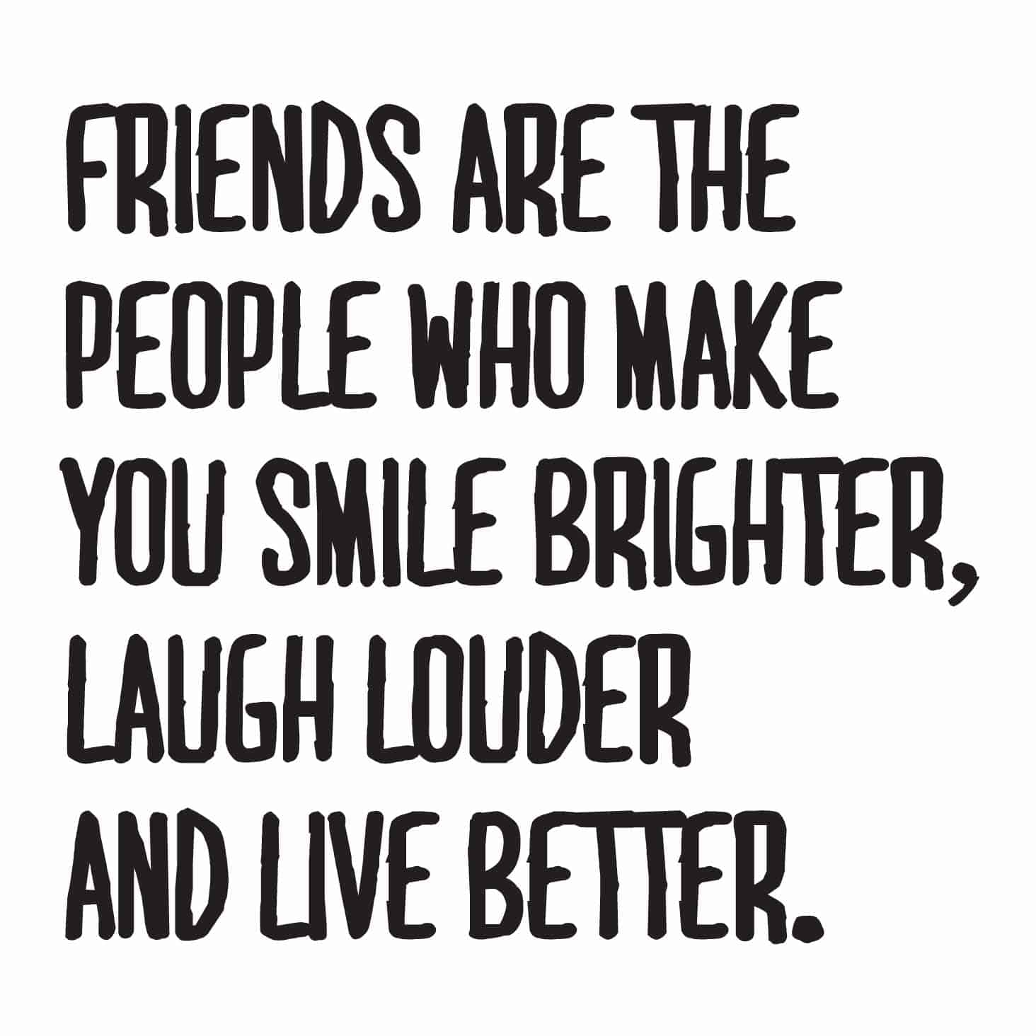
Individual Planning Discussion
When guiding future planning discussions always include recreation, socialization and leisure as an essential support and
service.
The DDS website has a list of many recreation and social opportunities available throughout the state, both DDS and
community sponsored activities Leisure Resources (ct.gov)
Why friends are so important ? -Psychology Today
Having solid friendships is important for two main reasons. First, they make life more enjoyable. We get to share the beautiful aspects of life with people who we love, which can enrich our everyday experiences. Second, our friends help us through the difficult times. Having friends to support us through hard times can make unimaginably difficult situations seem more tolerable.

